Slide 1
Orientation
GAME 256

Slide 2
Orientation
Matrices
Euler Angles
Quaternions

Slide 3

Matrices
$$\left[\begin{matrix}0.657 & −0.581 & −0.480 \\ 0.450 & 0.826 & −0.338 \\ 0.585 & 0.000 & 0.810\end{matrix}\right]$$
A matrix is a rectangular array containing numeric values, or something that can be used to derive a numeric value (expressions, symbols, etc.)

Slide 4

Addition
$$\left[\begin{matrix}1 & 0 \\ 0 & 1\end{matrix}\right]+\left[\begin{matrix}0 & 1 \\ 1 & 0\end{matrix}\right]=\left[\begin{matrix}1+0 & 0+1 \\ 0+1 & 1+0\end{matrix}\right]=\left[\begin{matrix}1 & 1 \\ 1 & 1\end{matrix}\right]$$
$$\left[\begin{matrix}1 & 0 \\ 0 & 1\end{matrix}\right]−\left[\begin{matrix}0 & 1 \\ 1 & 0\end{matrix}\right]=\left[\begin{matrix}1−0 & 0−1 \\ 0−1 & 1−0\end{matrix}\right]=\left[\begin{matrix}1 & −1 \\ −1 & 1\end{matrix}\right]$$

Slide 5

Multiplication
$$\left[\begin{matrix}a & b & c \\ d & e & f\end{matrix}\right]\left[\begin{matrix}z & y \\ x & w \\ v & u\end{matrix}\right]=\left[\begin{matrix}az+bx+cv & ay+bw+cu \\ dz+dx+dv & dy+ew+fu\end{matrix}\right]$$
$$\left[\begin{matrix}z & y \\ x & w \\ v & u\end{matrix}\right]\left[\begin{matrix}a & b & c \\ d & e & f\end{matrix}\right]=\left[\begin{matrix}za+yd & zb+ye & zc+yf \\ xa+wd & xb+we & xc+wf \\ va+ud & vb+ue & vc+uf\end{matrix}\right]$$

Slide 6
Advantages & Disadvantages
Advantages
  Can immediately rotate vectors between object and world space.
  Used by Graphics APIs (OpenGL, DirectX).
  Can collapse nested coordinate space relationships via matrix multiplication.
Disadvantages
  Needs 9 numbers.
  Difficult to read.
  Can be malformed (rounding errors, non-orthogonality).
  Have to worry about handedness
    OpenGL right handed*
    DirectX left handed

Slide 7

Euler Angles
$$\left[\begin{matrix}x & y & z\end{matrix}\right]$$
$$\left[\begin{matrix}pitch & roll & yaw\end{matrix}\right]$$
Euler angles describe the orientation of a rigid body as rotations about the axes of a coordinate system.

Slide 8
Advantages & Disadvantages
Advantages
  Much easier to use, compared to matrices and quaternions.
  Only 3 numbers are needed.
  Any 3 numbers are a valid orientation.
Disadvantages
  Any given angle has a set of Euler angles that can represent it.
    Add 360°.
    Angles are not independent.
  Interpolating between angles is difficult. GIMBAL LOCK.

Slide 9

Quaternions
$$\left[w, \left(\begin{matrix}x & y & z\end{matrix}\right)\right]$$
To construct a quaternion that rotates about an arbitrary axis A:
$$q=cos\frac{θ}{2}+Asin\frac{θ}{2}$$
Quaternions are a number system that makes use of complex numbers ($\sqrt{−1}$).
$$a+bi+cj+dk$$
Where i, j, and k, are all fundamental quaternion units.

Slide 10
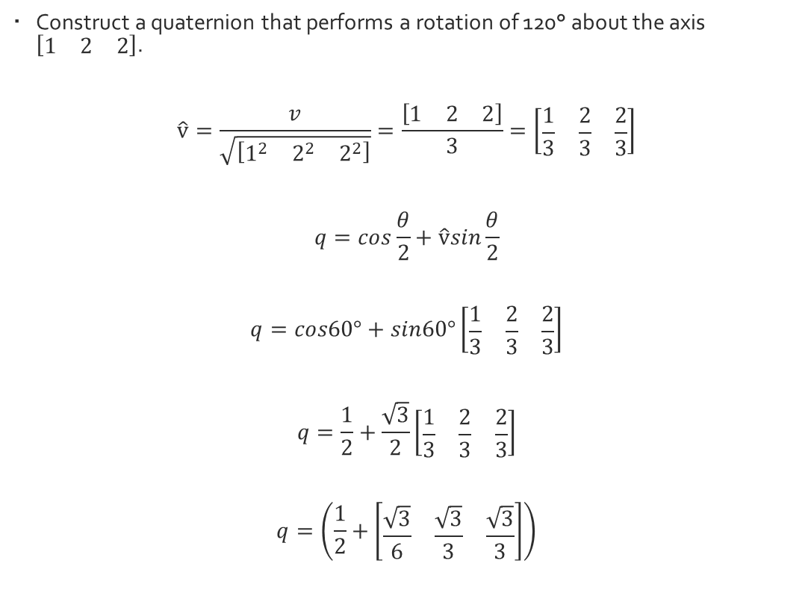
Examples
Construct a quaternion that performs a rotation of 120° about the axis $\left[\begin{matrix}1 & 2 & 2\end{matrix}\right]$.
$$\hat{v}=\frac{v}{\sqrt{\left[\begin{matrix}1^{2} & 2^{2} & 2^{2}\end{matrix}\right]}}=\frac{\left[\begin{matrix}1 & 2 & 2\end{matrix}\right]}{3}=\left[\begin{matrix}\frac{1}{3} & \frac{2}{3} & \frac{2}{3}\end{matrix}\right]$$
$$q=cos\frac{θ}{2}+\hat{v}sin\frac{θ}{2}$$
$$q=cos60°+sin60°\left[\begin{matrix}\frac{1}{3} & \frac{2}{3} & \frac{2}{3}\end{matrix}\right]$$
$$q=\frac{1}{2}+\frac{\sqrt{3}}{2}\left[\begin{matrix}\frac{1}{3} & \frac{2}{3} & \frac{2}{3}\end{matrix}\right]$$
$$q=\left(\frac{1}{2}+\left[\begin{matrix}\frac{\sqrt{3}}{6} & \frac{\sqrt{3}}{3} & \frac{\sqrt{3}}{3}\end{matrix}\right]\right)$$

Slide 11
Advantages & Disadvantages
Advantages
  Only 4 numbers needed.
  No Gimbal Lock.
Disadvantages
  Not intuitive.
  Can become invalid through bad data or round off errors.

Slide 12

Classwork
Construct a quaternion that performs a rotation of 60° about the axis $v=\left[\begin{matrix}2 & 1 & −2\end{matrix}\right]$

Slide 13

Answer
$$q=\left(\frac{\sqrt{3}}{2}+\left[\begin{matrix}\frac{1}{3} & \frac{1}{6} & −\frac{1}{3}\end{matrix}\right]\right)$$

Slide 14

Classwork
What type of rotation is represented by the following quaternion?
$$q=\left(0.965 \left[\begin{matrix}0.149 & −0.149 & 0.149\end{matrix}\right]\right)$$

Slide 15

Answer
A rotation of 30.4° about the unit vector axis $\left[\begin{matrix}0.568 & −0.568 & 0.568\end{matrix}\right]$

Slide 16
Fin

